Slide 1

A STUDY ON OPTIMIZING QUERY RESOLUTION IN CORPORATE SETTINGS, FROM WHATSAPP TO ZOHO DESK
Presented by – Poulomi Jana Roll No. – I302

Slide 2


Company Overview
Leading diagnostic company with pan-India operations.
Queries raised by ASMs and RSMs.
Earlier handled via WhatsApp - caused delays and confusion.
Shifted to Zoho Desk for structured workflow and tracking.

Slide 3
Problem Identification & Objectives
Problems with WhatsApp-based system:
No record, tracking, or follow-up mechanism.
Missed responses and accountability issues.
Research Objectives:
To Identify inefficiencies in the WhatsApp-based query handling system.
To design and implement a Zoho Desk workflow integrated with Zoho Forms.
To evaluate on-time vs delayed query resolution rates before and after Zoho Desk adoption.

Slide 4
Research Methodology
Type: Primary research using Zoho Desk data.
Period: June–August 2025.
Total Queries: 637 (June 213, July 262, August 162).
Method: Stratified sampling by month, region, and product line.
Ensured confidentiality through anonymized data.

Slide 5

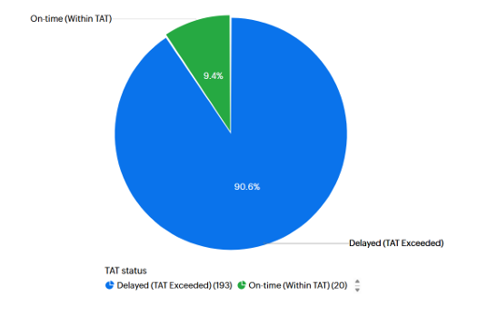
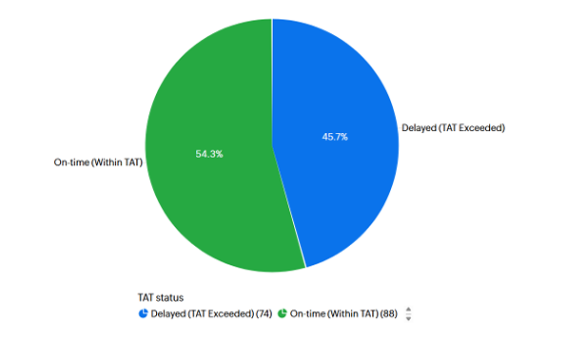
Analysis & Findings
On-time resolution improved from 9.4% → 54.3 % (June to August).
Significant reduction in delays from 90.6% to 45.7% (June to August).
Role clarity reduced informal follow-ups & enhanced accountability.

Slide 6

Key Limitations & Suggestions
Short time frame
2
External factors not accounted for
1
Limited scope
3
Full Adoption of Zoho Desk Workflows
Regular Training and Capacity Building
Promote Accountability and Ownership

Slide 7
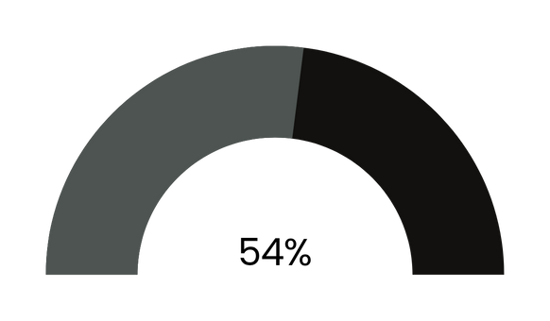
Conclusion
Improved accountability and transparency
Faster resolution times
Enhanced tracking and data-based decision-making

Slide 8


